Slide 1

3D Volume Viewer Overview
2019.07.08
Rapiscan Systems
Karthik Bala
KBVIS Technologies Pvt. Ltd.
3d@kbvis.com
Notes:
1

Slide 2
DAY 1
Notes:
2

Slide 3
Setup and Resources
WebGL 3D DICOM Viewer (and test DICOM volume)
http://kbvis.com/downloads/rapiscan-papaya-viewer.zip
Notes:
3

Slide 4

Digital Imaging and Communications in Medicine
Standard for the communication and management of medical imaging across devices, workstations, networks, PACS
Vendor-independent, where DICOM conformant
Derivations:
DICONDE – Non destructive testing
DICOS – Security applications

Slide 5
Equipment Types
CT (computed tomography)
MRI (magnetic resonance imaging)
Ultrasound
X-ray
Fluoroscopy
Angiography
Mammography
Breast tomosynthesis
PET (positron emission tomography)
SPECT (single photon emission computed tomography)
Endoscopy
Microscopy
Whole slide imaging
OCT (optical coherence tomography)
PACS (picture archiving and communication systems)
Image viewers and display stations
CAD (computer-aided detection/diagnosis systems)
3D visualization systems
Clinical analysis applications
Image printers
Film scanners
Media burners (that export DICOM files onto CDs, DVDs, etc)
Media importers (that import DICOM files from CDs, DVDs, USBs, etc)
RIS (radiology information systems)
VNA (vendor-neutral archives)
EMR (electronic medical record) systems

Slide 6
Imaging Studies
Study – Patient scan data consisting of one or more image series
Series – Set of images from a single scan, or secondary capture.
Image – represents single section or slice through the anatomy
Volume Image – Series acquired from a volume scan. Constituent images have consistent spacing, orientation

Slide 7
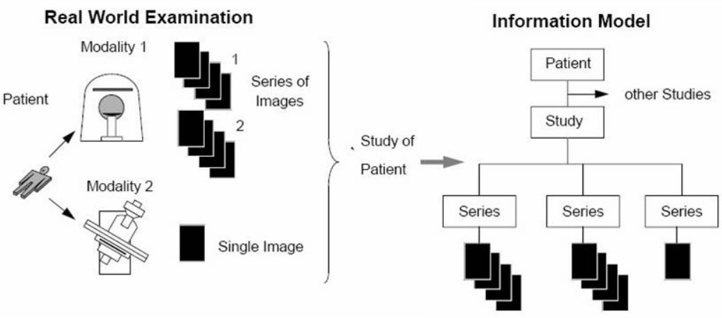

Slide 8
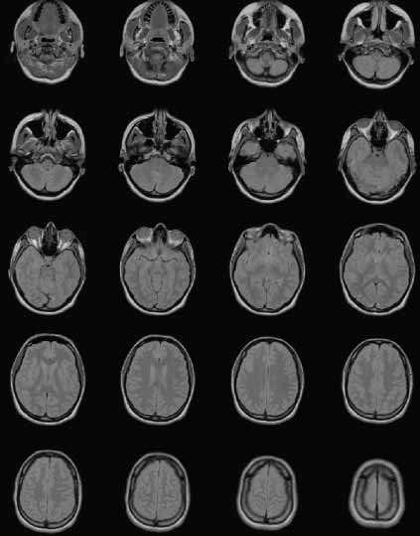
Image Series

Slide 9
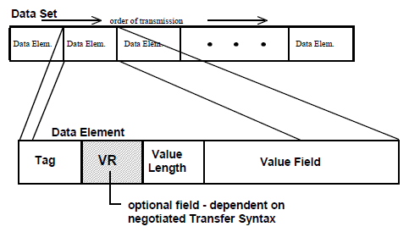
DICOM Parsing

Slide 10
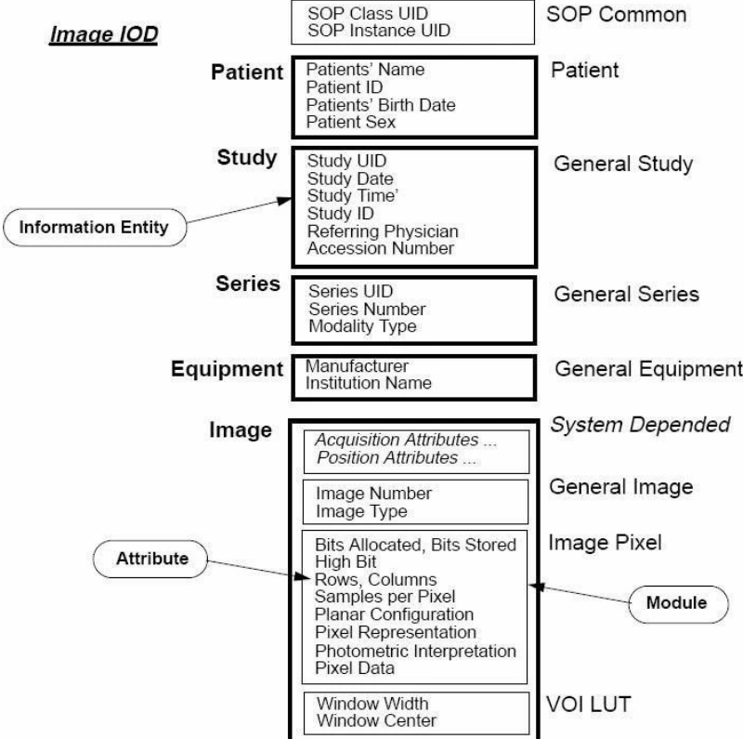

Slide 11
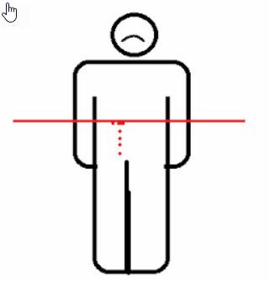
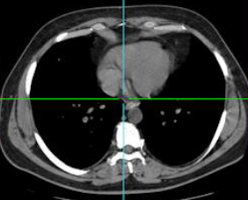
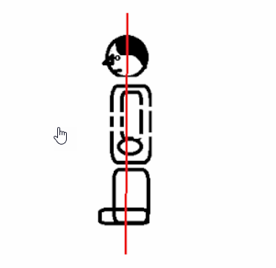
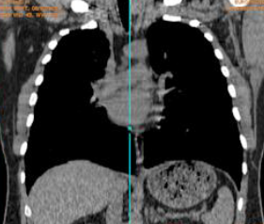
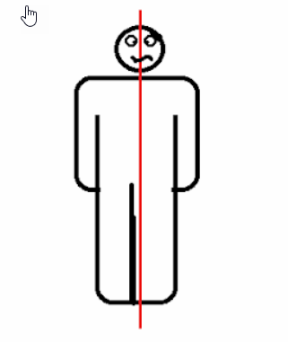
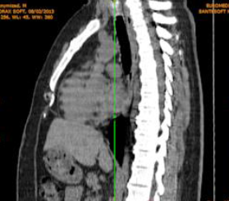
2D Imaging
Axial/Transverse
Coronal
Sagittal

Slide 12
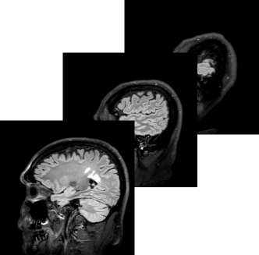
2D Viewing
Cine – Images are viewed in their original plane (say axial) one-by-one
MPR (Multi Planar Reformat) – Volume is resampled along different planes
MPR Slab – Multiple MPR sections are combined/blended
Window/Level – Intensity range of interest is mapped to viewable range of display (usually 8-bit grayscale or 24-bit color)

Slide 13
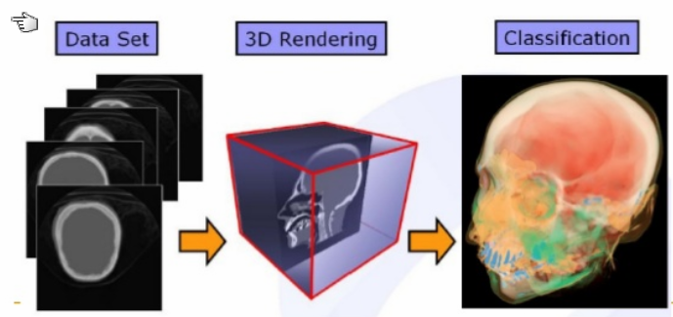
3D Volume Visualization
2D Images are combined to constitute a 3D volume
3D Volume is resampled using trilinear sampling to generate:
Resampled slices/slabs along any orientation (Obliques / MPR )
Isosurfaces
Blended projections of the volume (direct volume rendering)
Compositing / MIP / MinIP

Slide 14
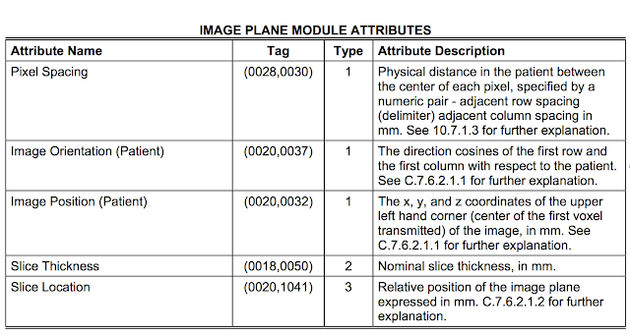
DICOM Header

Slide 15
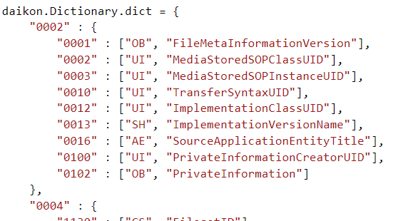
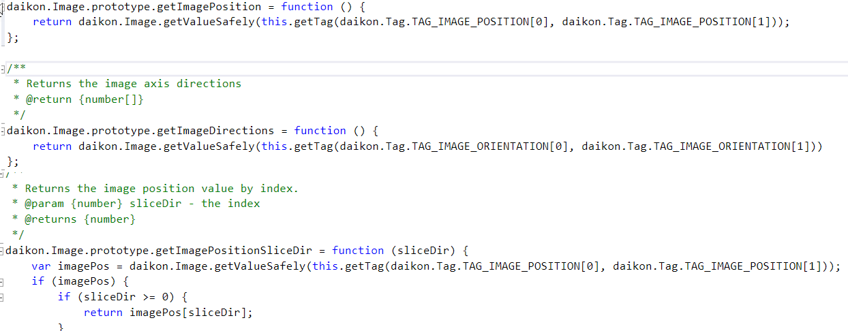
Daikon Reader

Slide 16
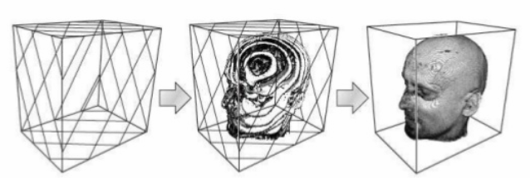
3D Texture Slicing
View-Aligned slices through 3D Texture
Color values at samples obtained from LUT / Transfer Function
Slices are blended using Compositing/MIP/MinIP operators

Slide 17
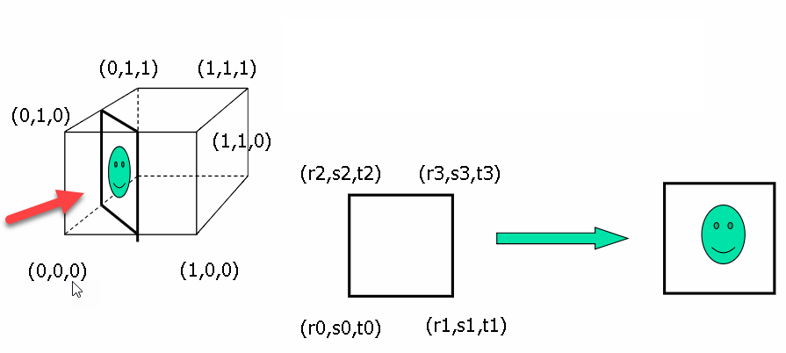
3D Texture Slicing
Transform texture coordinates of slicing quad according to the current view
Draw textured quad using transformed texture coordinates
Repeat by stepping the textured quad along the volume extents

Slide 18
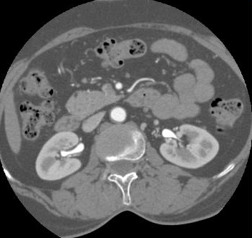
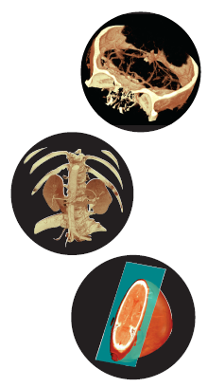
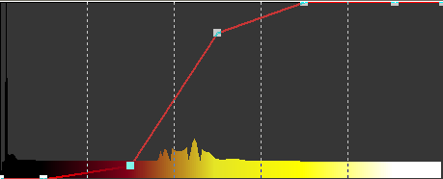
Color Tables
Source image
(12 bit grayscale)
color table (4096 entries)
color index lookup:
(unsigned int) (R,G,B,A)
Notes:
18

Slide 19
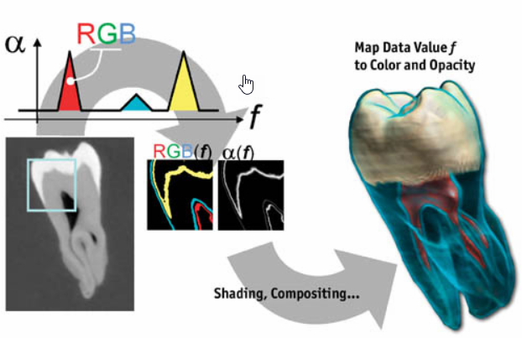
Color/Opacity Lookup (Classification)

Slide 20
Window/Level
Select range of intensities to display
e.g. if DICOM data is 12-bit, then map a range of the 4096-level intensity range to 256-level display range
Window Width – size of intensity range
Level – Centre of Window

Slide 21
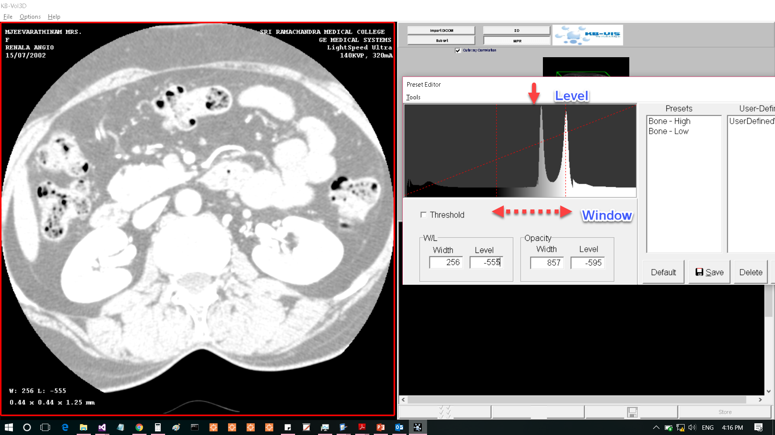
Window = 256, Level = -555 (HU)
Most data visible
High-intensity areas are saturated

Slide 22
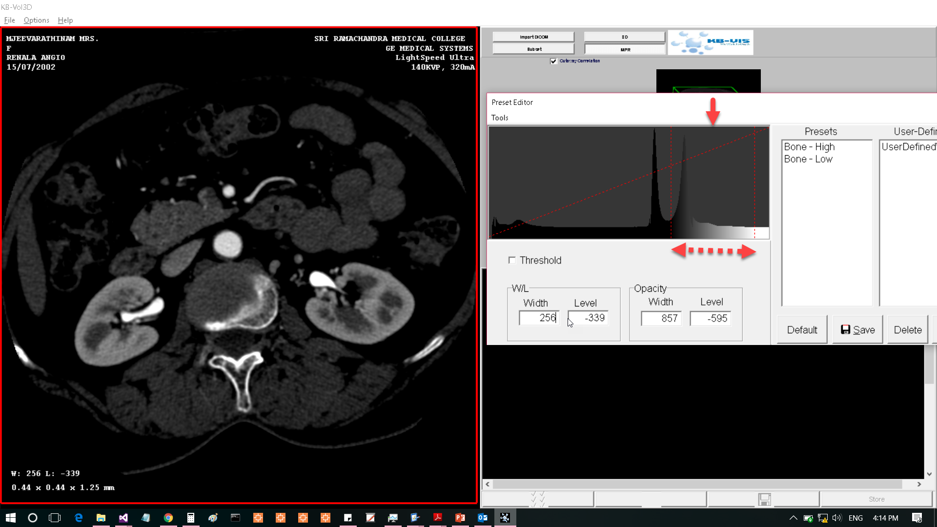
Window = 256, Level = -339 (HU)
Less saturation in high-intensity regions
Low-intensity regions less visible

Slide 23
Review: Transparency and Blending Volume Rendering WebGL 3D Texture
Notes:
23

Slide 24
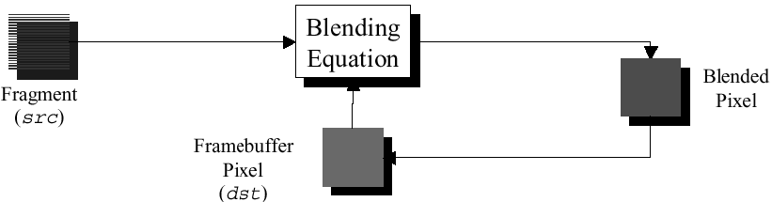
Transparency & Blending
Blending colors to make objects appear translucent
glEnable(GL_BLEND)
Blending function specifies how color values from a
source and a destination are combined:
glBlendFunc(GLenum sfactor, GLenum dfactor)
color values of incoming fragment (source) are combined with the color values of the corresponding currently stored pixel (destination):
Cdest = Csource * sfactor + Cdest * dfactor
Notes:
24

Slide 25
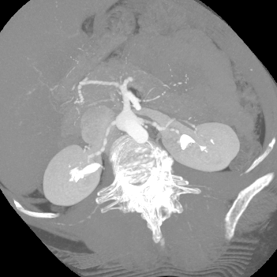
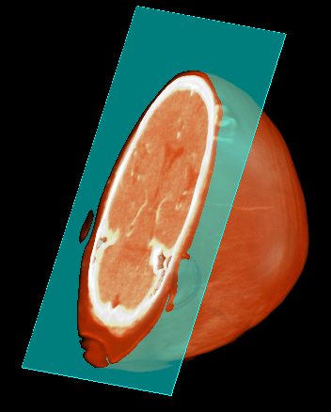
Blend Function
glBlendEquation(GL_MAX)
glBlendFunc( GL_SRC_ALPHA, GL_ONE_MINUS_SRC_ALPHA)
Notes:
25

Slide 26
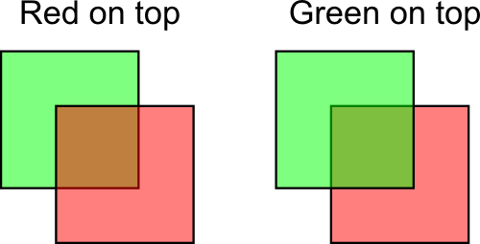
“Over” Operator

Slide 27
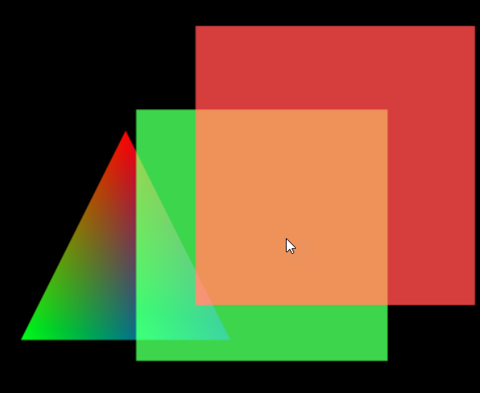
Example: Blending
See: example10-transparency-and-blending
Notes:
27

Slide 28
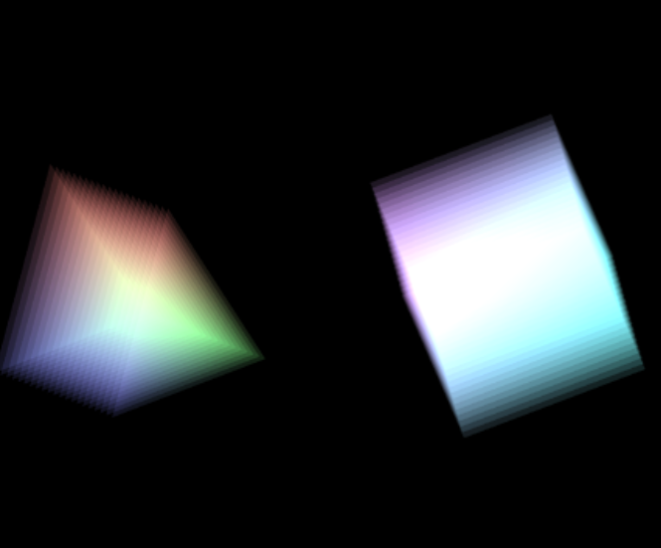
Example: Transparent Stack
See: example10-transparency-and-blending
Notes:
28

Slide 29
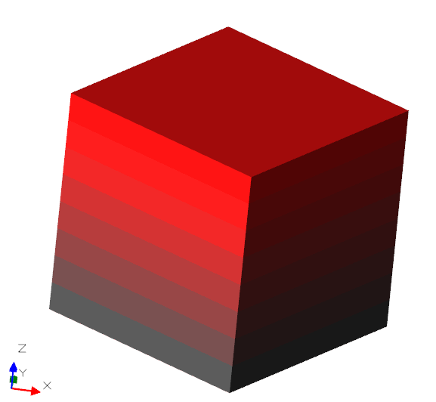
Example: 3D Texture
See: example11-3d-texture
Notes:
29

Slide 30
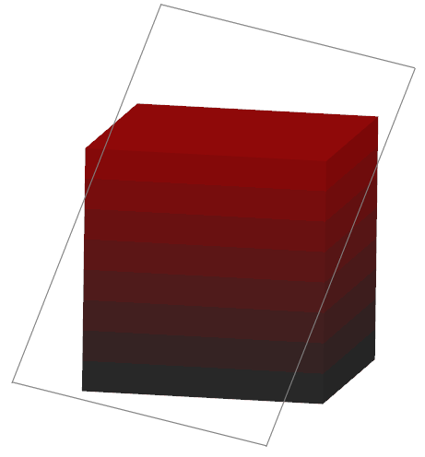

Sampling the 3D Texture
Use 3D texture coordinates (s,t,p) as vertex attributes
In glTexParameter use TEXTURE_WRAP_R for third texture dimension

Slide 31
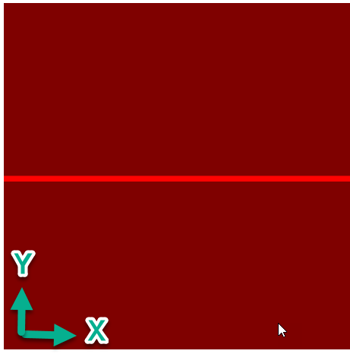
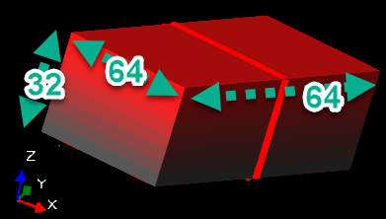
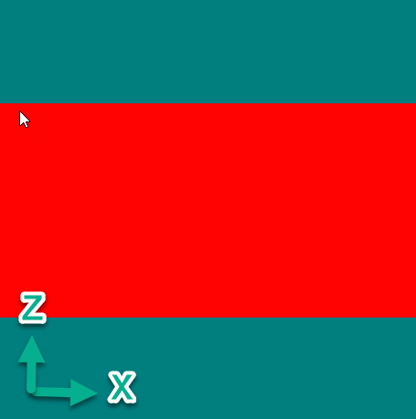
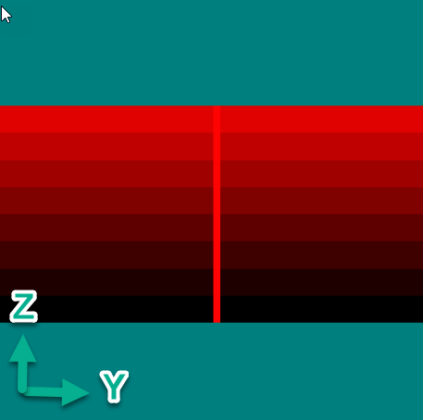
Simplified Example – Standard Slice Planes
Axial (XY)
Coronal (XZ)
Sagittal (YZ)

Slide 32
DAY 2
Notes:
32

Slide 33
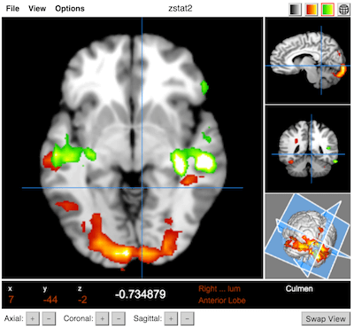
Papaya Viewer
Open-source Javascript DICOM viewer
Uses Daikon DICOM reader
2D Standard Views – no obliques or slabs
Isosurfacing
No Volume Rendering
Uses Javascript – no graphics acceleration
Slow on large data

Slide 34
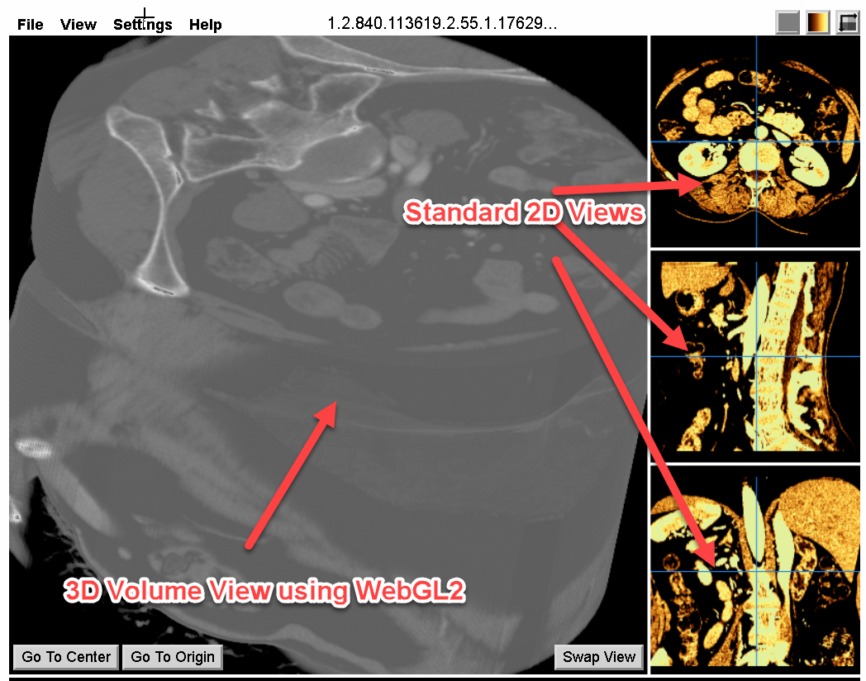
Rapiscan WebGL Volume Viewer
3D Volume Rendering view based on WebGL 2.0
Volume rendering code in rapiscanVolume.js added to Papaya codebase
Grayscale, Color, and Transparency with Window/Level and Opacity control
Integrated with Papaya Color Tables
Cut-Planes dynamically updating with MPR crosshairs
Source Code: rapiscan-examples-webgl\rapiscan-papaya-viewer

Slide 35
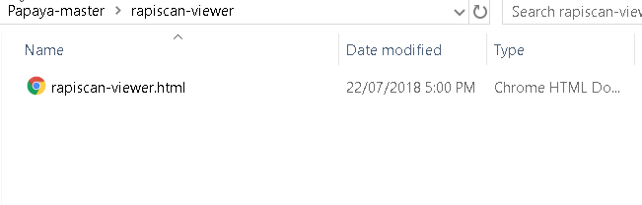
Rapiscan WebGL Viewer

Slide 36
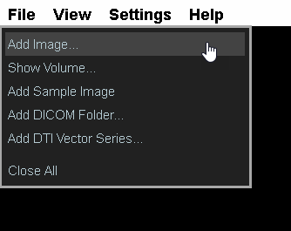
Load DICOM Series
Use Add Image, and select a .DCM multiframe volume series file
Or, use Add DICOM Folder and choose folder containing files from a single Volume Series

Slide 37
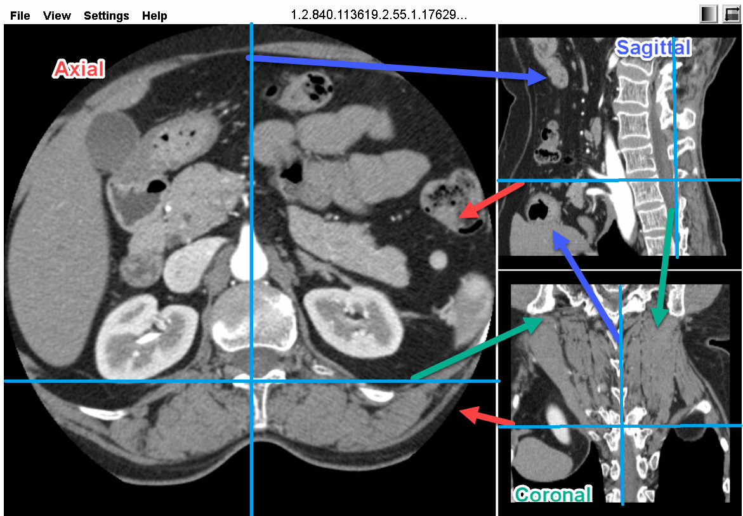
2D Views (MPR) – Axial, Coronal Sagittal
Moving crosshairs updates the MPR views

Slide 38
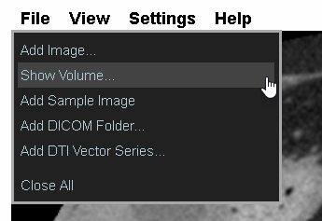
Load Volume
Loads current series as 3D Volume
Current series must constitute a valid DICOM volume

Slide 39
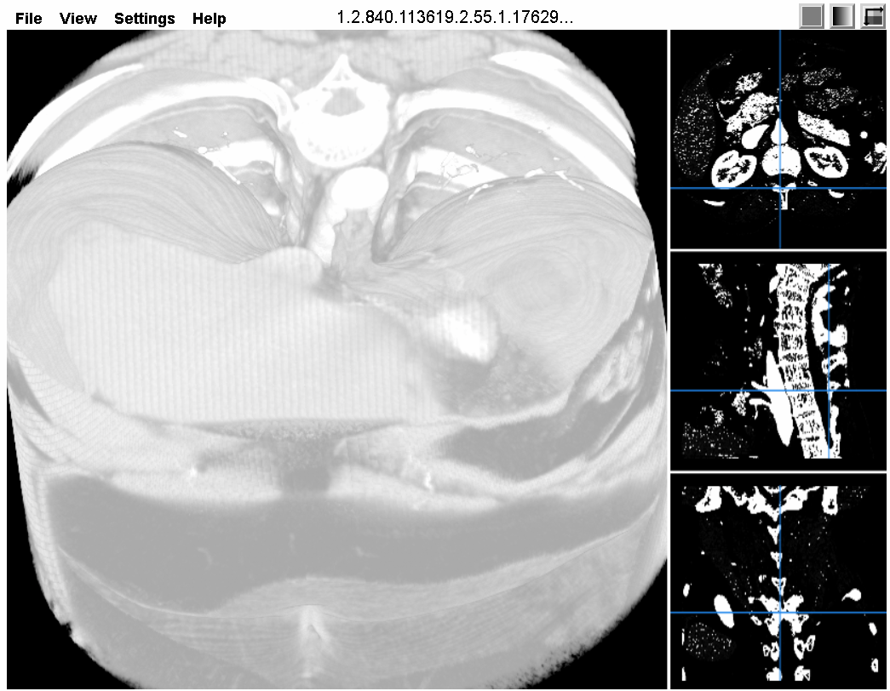
Volume is loaded with default window/level based on data histogram

Slide 40
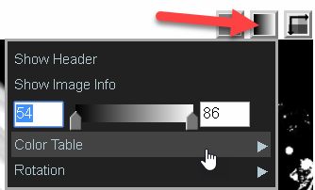
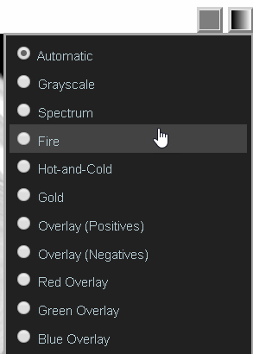
Color Tables
Grayscale/Color RGBA LUTs
16-bit intensity is used to look up 256-entry table

Slide 41
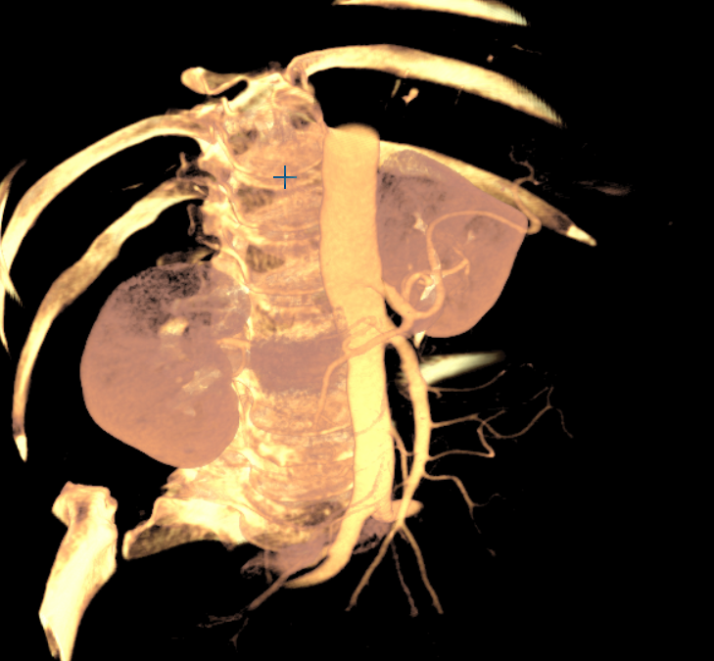
Window-Level and Opacity
Right-mouse + Horizontal drag Window width
Right-mouse + Vertical drag Level
Press Ctrl for Opacity

Slide 42
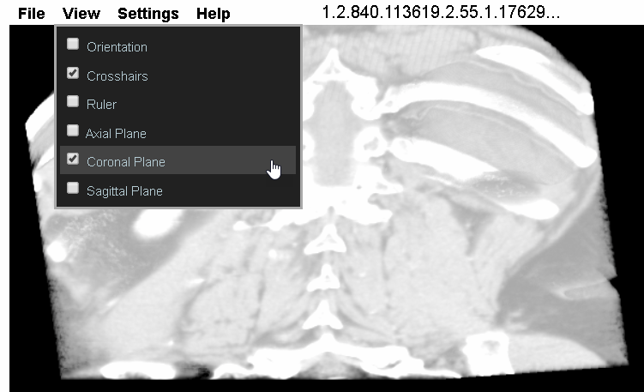
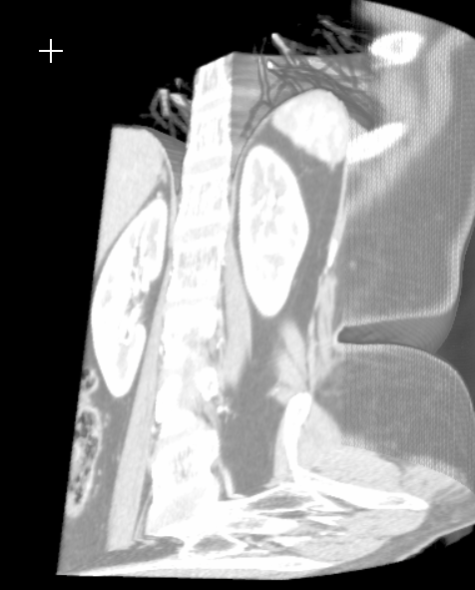
Cut-Planes
Axial/Coronal/Sagittal Cut-Planes
Cut-Plane updates when corresponding crosshair is moved

Slide 43
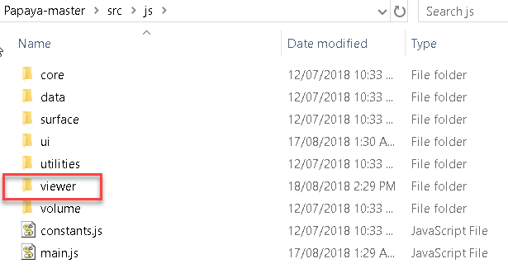
Papaya Viewer Source

Slide 44
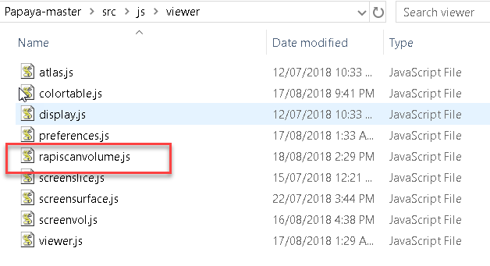
Rapiscan WebGL Viewer Source

Slide 45
Main Components
Main.js – application container
Toolbar.js – UI Commands, Settings
Viewer.js – main viewer class
ScreenVol.js – encapsulates DICOM volume
ScreenSlice.js – 2D MPR viewer
RapiscanVolume.js – WebGL2 Volume Viewer
ColorTable.js – RGBA Color Tables
Daikon.js – DICOM parsing

Slide 46
papaya.viewer.Viewer Key Members
screenVolumes – volume containers currently loaded. A screen volume contains a DICOM volume and its associated properties and settings e.g. color table
currentScreenVolume – screen volume currently active in viewer
volume – base DICOM volume loaded in viewer (any additional volumes are overlaid on this). This is used by the volume viewer
axial/coronal/sagittalSlice – ScreenSlice instances containing MPR 2D views
volumeView – Volume rendered view
mainImage/lowerImageBot/lowerImageTop/ lowerImageBot2 – views mapped to volume and MPR views (can be swapped)
currentCoord – Current MPR crosshair position
selectedSlice – Currently active slice, that user action is originating from

Slide 47
papaya.viewer.Viewer Key Methods
drawViewer – top-level draw, triggers all other necessary draws
drawScreenSlice – recomputes and draws 2D MPR views. Implemented in Javascript, does not use WebGL
drawCrosshairs – draws MPR crosshairs based on current cursor position (currentCoord)
windowLevelChanged – updates W/L (e.g. on mouse drag) and redraws slices, passes on event to volume view
opacityChanged - passes on event to volume view
load3dVolume – creates volume screen container and adds volume view
initializeVolume – creates RapiscanVolume instance with currently loaded DICOM volume
updatePosition – updates current position in volume, updates MPR views, triggers volume update if cut-plane is enabled
mouse event handlers – trigger update of 2D and volume views e.g. W/L, rotate, zoom, crosshair drag

Slide 48
papaya.viewer.RapiscanVolume Interface
Constructor:
papaya.viewer.RapiscanVolume()
Volume view refresh:
draw()
Select color table (Settings)
changeColorTable(lutName)
Window/Level and Opacity mouse action:
updateLut(minIntensity, maxIntensity, isOpacity)
Cut-plane update on MPR crosshair drag:
updateVolume(currentCoord, draggingSliceDir)

Slide 49
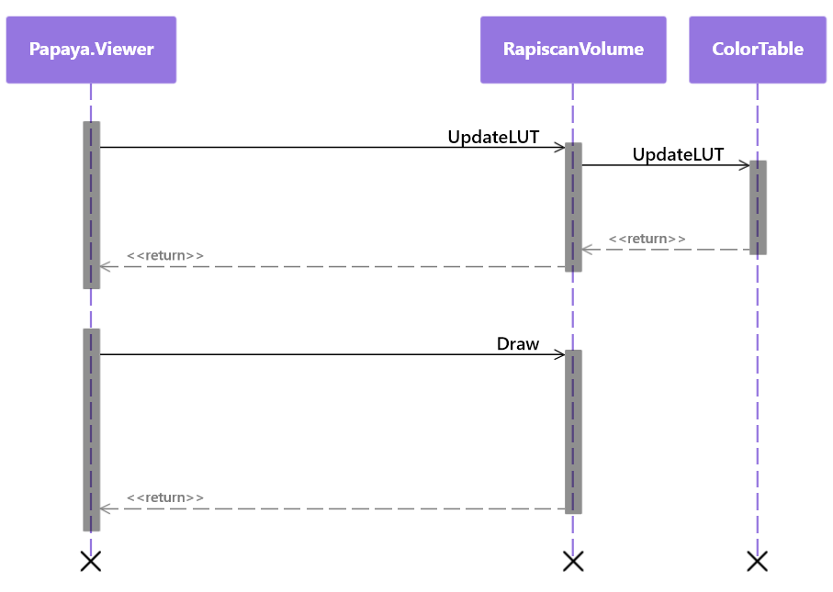
RapiscanVolume Events

Slide 50
RapiscanVolume Methods
Initialize()
Initializes canvas, WebGL2 context
Initializes the view (orthographic projection)
Sets up shaders
Creates and initializes GL buffers

Slide 51
RapiscanVolume Methods
Draw()
Calls Initialize() the first time
Calls DrawScene() for GL drawing
DrawScene()
Sets up matrices based on current rotation
Updates mvMatrix based on rotation state
Updates texMatrix (used to transform texture coordinates of the volume sampling/slicing plane)
Sets shader uniforms
Calls BindVolume() to load the volume (initially)
Calls RenderVolume() to render the volume

Slide 52
RapiscanVolume Methods
BindVolume()
creates 3D texture and load its using the 8/16-bit volume data from the DICOM file
3D texture is loaded using glTexImage3D()
16-bit intensities are stored in UNSIGNED_SHORT_4_4_4_4 texture format and repacked in the shader
3D texture is padded to power-of-2 dimensions, as WebGL support for NPOT textures is patchy (no longer needed)
RenderVolume()
draws volume rendered view
draws stack of view-aligned slices that are 3D textured using the volume data
blending is enabled, and fragments are composited using the "over" operator

Slide 53
RenderVolume()
// draw a stack of view-aligned slices that are 3D textured using the volume data
// generate enough slices to cover volume extent
var sliceCount = this.maxDim;
// use matrix to transform texture coordinates of textured quad
var tempMat = mat4.create();
mat4.set(this.texMatrix, tempMat); // texMatrix contains current volume rotation
var zdir = vec3.create();
vec3.set([0,0,1], zdir); // view direction is along z-axis
var startTrans = vec3.create();
vec3.scale(zdir, -1.732/2.0, startTrans); // translate to one end of the volume
mat4.translate(tempMat, startTrans);
var viewStep = vec3.create();
vec3.scale(zdir, 1.732 / sliceCount, viewStep); // compute incremental step vector

Slide 54
RenderVolume()
// repeatedly draw textured slice, stepping through the volume,
// with blending enabled
for (var slice = 0; slice < sliceCount; ++slice) {
// step through the stack by applying incremental translation
mat4.translate(tempMat, viewStep);
// pass updated matrix to shader
gl.uniformMatrix4fv(this.shaderProgram.texMatrixUniform, false, tempMat);
// draw the textured quad (view-aligned volume slice)
gl.drawArrays(gl.TRIANGLE_STRIP, 0, 4);
}

Slide 55
3D Texture Slicing
View-Aligned slices through 3D Texture
Color values at samples obtained from LUT / Transfer Function
Slices are blended using Compositing/MIP/MinIP operators

Slide 56
Vertex Shader
in vec3 aVertexPosition;
in vec3 aVertexTexCoord;
// projection matrix
uniform mat4 uPMatrix;
// transforms texture coordinates of textured slice
uniform mat4 uTexMatrix;
// output to fragment shader
out vec3 vTransformedTexCoord;
void main(void) {
// transform texture coordinates to account for volume rotation
// and current slice position
vec4 transformedTexCoord = uTexMatrix * vec4(aVertexTexCoord, 1.0);
// pass to fragment shader for interpolation
vTransformedTexCoord = transformedTexCoord.xyz;
gl_Position = uPMatrix * vec4(aVertexPosition, 1.0);
}

Slide 57
Fragment Shader
uniform vec3 uVolumeCoord; // current slice plane location
uniform bool uVolumeSlice; // in volume render mode?
uniform int uSlicePlane; // slice plane linked to axial / coronal / sagittal MPR
uniform int uBytesPerPixel; // 1 or 2 (8 or 16 bits)
uniform sampler3D uVolumeSampler; // volume texture
uniform sampler2D uLutSampler; // lookup table texture (256x1 2D texture)
in vec3 vTransformedTexCoord;
out vec4 fragColor;
void main(void) {
fragColor = vec4(0.0,0.0,0.0,1.0);
// discard fragment if outside texture limits
if(vTransformedTexCoord.x < 0.0 || vTransformedTexCoord.y < 0.0 ||vTransformedTexCoord.z < 0.0 || vTransformedTexCoord.x > 1.0
|| vTransformedTexCoord.y > 1.0 || vTransformedTexCoord.z > 1.0){
discard;
}

Slide 58
Fragment Shader
if (uVolumeSlice) {
// sample 3D texture along the current slice
fragColor = texture(uVolumeSampler, vTransformedTexCoord);
// repack 4-bit components into single 16-bit unsigned int
float lutIndex = uBytesPerPixel > 1 ?
fragColor.g + fragColor.b/16.0 + fragColor.a/256.0 : fragColor.r;
// look up volume texture using 16-bit intensity index
fragColor = texture(uLutSampler, vec2(lutIndex, 0.0));
if(fragColor.a < 0.05) discard; // very low alpha, do not output
else{
// if slice plane is enabled, then check if fragment is on visible
side, or is clipped away
if(uSlicePlane == 1){ //AXIAL
if(dot(vTransformedTexCoord - vec3(0.5,0.5,0.5), vec3(0.0,0.0,1.0)) < uVolumeCoord.z - 0.5) discard;
}else if(uSlicePlane == 2){ //CORONAL
if(dot(vTransformedTexCoord - vec3(0.5,0.5,0.5),
vec3(0.0,1.0,0.0)) < uVolumeCoord.y - 0.5) discard;
}else if(uSlicePlane == 3){ //SAGITTAL
if(dot(vTransformedTexCoord - vec3(0.5,0.5,0.5),
vec3(1.0,0.0,0.0)) < uVolumeCoord.x - 0.5) discard;
}
}
}

Slide 59
Surface Shading
if(uShaded){
// sample volume on either side of current voxel
vec3 gradient;
gradient.r = intensity(texture(uVolumeSampler, transformedTexCoord(vVertexTexCoord + vec3(uVoxelSize.x, 0.0, 0.0))),uBytesPerPixel);
gradient.g = intensity(texture(uVolumeSampler, transformedTexCoord(vVertexTexCoord + vec3(0.0, uVoxelSize.y, 0.0))),uBytesPerPixel);
gradient.b = intensity(texture(uVolumeSampler, transformedTexCoord(vVertexTexCoord + vec3(0.0, 0.0, uVoxelSize.z))),uBytesPerPixel);
vec3 gradient_back;
gradient_back.r = intensity(texture(uVolumeSampler, transformedTexCoord(vVertexTexCoord - vec3(uVoxelSize.x, 0.0, 0.0))),uBytesPerPixel);
gradient_back.g = intensity(texture(uVolumeSampler, transformedTexCoord(vVertexTexCoord - vec3(0.0, uVoxelSize.y, 0.0))),uBytesPerPixel);
gradient_back.b = intensity(texture(uVolumeSampler, transformedTexCoord(vVertexTexCoord - vec3(0.0, 0.0, uVoxelSize.z))),uBytesPerPixel);
// compute surface normal using central-difference
gradient = 0.5*(gradient - gradient_back);

Slide 60
Surface Shading
if(length(gradient) > 0.05){
gradient = normalize(gradient);
// assume light and viewing directions along z-axis
vec3 lightVec = vec3(0.0,0.0,1.0);
vec3 viewVec = vec3(0.0,0.0,1.0);
// compute dot product of normal and light vector
float NdotL = dot(-lightVec, gradient);
// compute dot product of normal and light vector
float NdotH = clamp(dot(viewVec, gradient), 0.0, 1.0);
// clamp to get diffuse luminance (when NdotL < 0, surface is not light-facing)
float lum = clamp(NdotL, 0.0, 1.0);
float gloss = 20.0;
// compute specular component (for shininess)
float spec = clamp(pow(NdotH, gloss), 0.0, 0.4);
// final shaded luminance
lum = clamp(lum + spec, 0.0, 1.0);
float brightness=1.0;
float contrast=1.0;
fragColor.r = clamp(contrast*(lum*fragColor.r-0.5)+ 0.5*brightness, 0.0, 1.0);
fragColor.g = clamp(contrast*(lum*fragColor.g-0.5)+ 0.5*brightness, 0.0, 1.0);
fragColor.b = clamp(contrast*(lum*fragColor.b-0.5)+ 0.5*brightness, 0.0, 1.0);
}
}

Slide 61
RapiscanVolume Methods
ChangeColorTable()
Loads new color selected in Papaya viewer
Calls updateLut() to update the LUT
UpdateLut()
Updates color table due to window-level/opacity change or color table change
Populates RGBA LUT based on current min/max intensity range
Calls colorTable.lookupRed/Green/Blue() to get RGB value for a given intensity
Updates LUT texture using glTexSubImage2D()

Slide 62

Color Table Event

Slide 63

Color Table Data Range
Data range is set from histogram in BindVolume()

Slide 64
Window/Level Event
papaya.viewer.Viewer.prototype.windowLevelChanged = function (windowChange, levelChange) {
var range, step, minFinal, maxFinal;
// compute change delta
var windowWidth = this.volumeLevelMax - this.volumeLevelMin;
step = Math.max(1.0, windowWidth * 0.025);
// adjust window or level depending on horizontal/vertical mouse drag
if (Math.abs(windowChange) > Math.abs(levelChange)) {
minFinal = this.volumeLevelMin + (step * papaya.utilities.MathUtils.signum(windowChange));
maxFinal = this.volumeLevelMax + (-1 * step * papaya.utilities.MathUtils.signum(windowChange));
} else {
minFinal = this.volumeLevelMin + (step * papaya.utilities.MathUtils.signum(levelChange));
maxFinal = this.volumeLevelMax + (step * papaya.utilities.MathUtils.signum(levelChange));
}
if (maxFinal <= minFinal) { // do not allow window width to become zero
minFinal = this.volumeLevelMin;
maxFinal = this.volumeLevelMax;
}
else { // update current W/L setting
this.volumeLevelMin = Math.max(0, Math.min(255, minFinal));
this.volumeLevelMax = Math.max(this.opacityMin, Math.min(255, maxFinal));
}
// update volume view with current W/L
this.volumeView.updateLut(this.volumeLevelMin, this.volumeLevelMax, false);
this.drawViewer(true);
};

Slide 65


Handling NPOT Textures
Handle Non-Power-Of-Two texture dimensions
Pad dimensions of allocated texture up to nearest POT
Offset and Scale the texture coordinates to account for the “gap”
Texture extents are 200/256 and 400/512 in X and Y i.e. (0.78, 0.78) instead of (1.0,1.0)
Use offset of (1.0 – 0.78)/2 to centre the texture
Update: Not needed as NPOT driver support has improved

Slide 66

updateVolumeView()

Slide 67

Handling Anisotropy
Handle different spatial dimensions along volume dimensions i.e. Width≠Height≠Depth
Texture coordinates always vary [0..1] across volume extents
Solution: apply 3D scaling in transformation matrix

Slide 68


Texture Matrix
Compute relative scale in each dimension (anisotropy factors)
Scale the texture matrix by relative scale in each dimension (x,y,z)

Slide 69


Handling Zoom
Alt + vertical mouse drag in volume view
Handled in Viewer.mouseDown and Viewer.mouseMove – mouse movement delta is used to update volumeView.zoom
RapiscanVolume.updateView() applies the zoom factor to the projection matrix in call to mat4.ortho()

Slide 70


Viewer.mouseMove()
RapiscanVolume.updateView()

Slide 71


Handling Pan
Alt + Shift + mouse drag in volume view
Handled in Viewer.mouseDown and Viewer.mouseMove – mouse movement delta is used to update volumeView.panX/Y
RapiscanVolume.updateView() applies the pan offset to the projection matrix in call to mat4.ortho()

Slide 72


Viewer.mouseMove()
RapiscanVolume.updateView()

Slide 73
2D MPR Slices
Handled in papaya.viewer.ScreenSlice
ScreenSlice.updateSlice() computes the MPR slices
Determines current “slice”, based on view and position
Depending on MPR view, slice plane can be:
Axial – XY plane
Coronal – XZ plane
Sagittal – YZ plane
Loop over XY / XZ / YZ volume indices
Sample volume data using Volume.getVoxelAtCoordinate(i,j,k)

Slide 74

RGB MPR View
No lookup – unpack RGB from 24-bit integer

Slide 75

Grayscale MPR View
Look up RGBA value from color table

Slide 76
DAY 3
Notes:
76

Slide 77

BIO 3D Viewer
Websocket-based stream instead of DICOS
See Git repository for current code snapshot

Slide 78
BIO 3D Viewer
Javascript/WebGL viewer receives streaming input not from DICOS files
3D volume chunks stream on websocket
2D dual-view scrolling image chunks stream on websocket
By default dual-view scrolling image view is active
Volume is loaded once all chunks are received
Inset preview thumbnail is displayed once volume is loaded

Slide 79


Slide 80
Key Methods
RapiscanVolume
onLoadChunk()
onDualViewUpdate()
onVolumeChunkUpdateMultiThreaded()
loadPapayaVolume()
onUserEvent()
onUserQuery()
drawScene()
renderVolume() / renderImage()
drawBoxOverlay()

Slide 81
Dual-View Image Scrolling
Javascript/WebGL viewer receives streaming input instead of DICOS files
3D volume chunks stream on websocket
2D dual-view scrolling image chunks stream on websocket
By default dual-view scrolling image view is active
Volume is loaded once all chunks are received
Inset preview thumbnail is displayed once volume is loaded

Slide 82
2D Scrolling Image Display
initImageShaders(): load 2D shaders
onDualViewUpdate(): handle incoming dual-view chunk - add it to the queue for processing
updateDualViewTexture(): update dual-view textured image based on new incoming image data
bindDualViewImage(): create dual view image 2D texture and rectangle
renderImage(): draw 2D textured image
startScrollTimer: scrolls the dual-view image by refreshing at regular intervals

Slide 83
2D Image Streaming
// timer is used to scroll the dual-view images
var timer = [false, false];
var timerVar = [null, null];
var startScrollTimer = function (that, view) {
timerVar[view] = setInterval(function () {
if (that.volumeViewType !== papaya.viewer.Viewer.VOLUME_VIEW_3D) {
that.viewer.drawViewer();
}
}, that.scrollInterval);
}
// process queued dual-view chunks to update scrolling image at regular intervals
papaya.viewer.RapiscanVolume.prototype.processQueuedChunks = function (view) {
if (!timer[view] && queuedDualViewChunks[view].length > 0) {
timer[view] = true;
var that = this;
setTimeout(function () {
startScrollTimer(that, view);
}, 100);
}
}

Slide 84
// handle incoming dual-view chunk - add it to the queue for processing
onDualViewUpdate = function (view, chunkIndex, cols, chunkRows, pixels) {
queuedDualViewChunks[view].push({ data: pixels, rows: chunkRows });
if (chunkIndex == 0) {
this.dualViewRows[view] = this.dualViewColumns[view] = cols;
this.currentChunkSlice = [0, 0];
this.dualViewImageTexture = [null, null];
if (!this.initialized) {
this.isVolumeReceived = false;
this.volume = new papaya.volume.Volume(this.viewer.container.display, this.viewer, this.viewer.container.params);
if (this.volumeTexture !== null) this.releaseVolume(this.context);
this.voxelBytes = 2;
this.xDim = this.volume.xDim = 16;
this.yDim = this.volume.yDim = 16;
this.zDim = this.volume.zDim = 16;
this.chunkedVolumeSliceCount = 0;
this.viewer.volume = this.volume;
this.viewer.initializeViewer();
}
}
if (chunkIndex > 2) {
this.processQueuedChunks(view);
}
}

Slide 85
Vertex Shader
uniform mat4 uPMatrix;
uniform float uScrollOffset;
in vec3 aVertexPosition;
in vec2 aVertexTexCoord;
out vec2 vVertexTexCoord;
void main(void) {
vVertexTexCoord = aVertexTexCoord + vec2(0.0, uScrollOffset);
gl_Position = uPMatrix * vec4(aVertexPosition, 1.0);
}

Slide 86
Fragment Shader
uniform sampler2D uImageSampler; // dual-view image texture
uniform sampler2D uLutSampler; // lookup table texture (256x1 2D texture)
uniform bool uBackgroundBlend;
in vec2 vVertexTexCoord;
out vec4 fragColor;
float intensity(vec4 rgba)
{
return rgba.g + rgba.b/16.0 + rgba.a/256.0;
}
void main(void) {
fragColor = texture(uImageSampler, vVertexTexCoord);
float lutIndex = intensity(fragColor);
fragColor = texture(uLutSampler, vec2(lutIndex, 0.0));
if(!uBackgroundBlend) fragColor.a = 1.0;
}

Slide 87
renderImage()
this.updateView(false); // set view for 2D image
gl.disable(gl.DEPTH_TEST);
// blending needed for background blend (if any)
gl.enable(gl.BLEND);
gl.blendFunc(gl.SRC_ALPHA, gl.ONE_MINUS_SRC_ALPHA);
// clear entire view with border color
gl.enable(gl.SCISSOR_TEST);
if (this.volumeViewType !== 0) {
switch (view) {
case 0: gl.scissor(0, gl.viewportHeight - viewportHeight, viewportWidth,
viewportHeight); break;
case 1: gl.scissor(viewportWidth, gl.viewportHeight - viewportHeight, viewportWidth,
viewportHeight); break;
}
gl.clearColor(this.mainBorderColor[0], this.mainBorderColor[1], this.mainBorderColor[2], this.mainBorderColor[3]);
gl.clear(gl.COLOR_BUFFER_BIT | gl.DEPTH_BUFFER_BIT);
}

Slide 88
renderImage()
// restrict draw area to within border
var border = 2;
switch (view) {
case 0: gl.scissor(border, gl.viewportHeight - viewportHeight + border, viewportWidth -
2 * border, viewportHeight - 2 * border); break;
case 1: gl.scissor(viewportWidth, gl.viewportHeight - viewportHeight + border,
viewportWidth - border, viewportHeight - 2 * border); break;
}
// clear area within border using background color
gl.clearColor(this.backgroundColor[0], this.backgroundColor[1], this.backgroundColor[2],
this.backgroundColor[3]);
gl.clear(gl.COLOR_BUFFER_BIT | gl.DEPTH_BUFFER_BIT);
switch (view) {
case 0: gl.viewport(border, gl.viewportHeight - viewportHeight + border,
viewportWidth - border, viewportHeight - border); break;
case 1: gl.viewport(viewportWidth + border, gl.viewportHeight - viewportHeight +
border, viewportWidth - border, viewportHeight - border); break;
}

Slide 89
renderImage()
if (this.dualViewImageTexture[view] !== null) {
// set up shader and texture
gl.disable(gl.CULL_FACE);
gl.useProgram(this.imageShader);
gl.activeTexture(view == 0 ? gl.TEXTURE2 : gl.TEXTURE3);
gl.bindTexture(gl.TEXTURE_2D, this.dualViewImageTexture[view]);
gl.uniform1i(this.imageShader.imageSamplerUniform, view == 0 ? 2 : 3);
gl.activeTexture(gl.TEXTURE0);
gl.bindTexture(gl.TEXTURE_2D, this.lutTexture);
gl.uniform1i(this.imageShader.lutSamplerUniform, 0);
// apply current scroll offset (effectively shifting/scrolling the image)
gl.uniform1f(this.imageShader.scrollOffsetUniform, chunkScrollOffset[view]);
gl.uniform1i(this.imageShader.backgroundBlend, this.backgroundColor[0] > 0 ||
this.backgroundColor[1] > 0 || this.backgroundColor[2] > 0);
// set up project matrix so that image fills the view
var halfsizeX = this.dualViewColumns[view] / 2.0;
var halfsizeY = this.dualViewRows[view] / 2.0;
var pMat = mat4.ortho(-halfsizeX, halfsizeX, -halfsizeY, halfsizeY, -halfsizeY, halfsizeY);
gl.uniformMatrix4fv(this.imageShader.pMatrixUniform, false, pMat);

Slide 90
renderImage()
// bind 2D texture corresponding to the dual-view image and draw
gl.bindBuffer(gl.ARRAY_BUFFER, this.imageVertAttributesBuffer[view]);
gl.enableVertexAttribArray(this.imageShader.vertexPositionAttribute);
gl.vertexAttribPointer(this.imageShader.vertexPositionAttribute, 3, gl.FLOAT, false, 20, 0);
gl.enableVertexAttribArray(this.imageShader.vertexTexCoordAttribute);
gl.vertexAttribPointer(this.imageShader.vertexTexCoordAttribute, 2, gl.FLOAT, false, 20, 12);
gl.drawArrays(gl.TRIANGLE_STRIP, 0, 4);
gl.disableVertexAttribArray(this.imageShader.vertexPositionAttribute);
gl.disableVertexAttribArray(this.imageShader.vertexTexCoordAttribute);
}
gl.disable(gl.SCISSOR_TEST);
// flag current view as being up-to-date
dualViewTextureUpdated[view] = false;
}

Slide 91
onVolumeChunkUpdateMultiThreaded()
if (chunkIndex == 0 && !isLoadingVolume) isReceivingChunks = true;
// do not interfere with 2D streaming to avoid lags
if (isLoadingVolume || !isReceivingChunks) return;
// starting new volume
if (chunkIndex == 0) {
this.chunkedVolumeSliceCount = 0;
this.viewer.clearBoxes();
}
// add volume chunks to queue
queuedVolumeChunks.push({ data: pixels, slices: chunkSlices });
transferables.push(pixels.buffer);
chunkSliceCounts.push(chunkSlices);
this.chunkedVolumeSliceCount += chunkSlices;

Slide 92
onVolumeChunkUpdateMultiThreaded()
// final chunk received – load the volume
if (endOfBag) {
this.isVolumeReceived = false;
this.volume = new papaya.volume.Volume(this.viewer.container.display, this.viewer, this.viewer.container.params);
if (this.volumeTexture !== null) { // unload previous volume
this.releaseVolume(this.context);
}
this.voxelBytes = 2;
this.xDim = this.volume.xDim = cols;
this.yDim = this.volume.yDim = rows;
this.zDim = this.volume.zDim = this.chunkedVolumeSliceCount;
histogram = new Uint32Array(65536);
this.viewer.volume = this.volume;
this.viewer.initializeViewer();

Slide 93
onVolumeChunkUpdateMultiThreaded()
// more volume setup
if (this.volumeData === null || currentAlloc < this.xDim * this.yDim * this.zDim) {
currentAlloc = Math.max(512, this.xDim) * Math.max(512, this.yDim) * Math.max(1024, this.zDim);
this.volumeData = new Uint16Array(currentAlloc);
console.log("onVolumeChunkUpdateMultiThreaded: current allocation = ", currentAlloc);
}
this.volume.imageData.data = this.volumeData;
// shared data for web worker
transferables.push(this.volumeData.buffer);
transferables.push(histogram.buffer);
isLoadingVolume = true;
isReceivingChunks = false;
this.initVolume();
this.texScaleX = this.xDim / this.texSizeX;
this.texScaleY = this.yDim / this.texSizeY;
this.texScaleZ = this.zDim / this.texSizeZ;
this.xHalf = (this.xDim * this.xSize) / 2.0;
this.yHalf = (this.yDim * this.ySize) / 2.0;
this.zHalf = (this.zDim * this.zSize) / 2.0;

Slide 94
onVolumeChunkUpdateMultiThreaded()
// setup volume-load web worker
var that = this;
function createWorker() {
var v = new Worker('worker/volumeWorker.js');
v.postMessage({ chunks: transferables, chunkSliceCounts: chunkSliceCounts, sliceSize: that.xDim * that.yDim, volumeAlloc: currentAlloc }, transferables);
queuedVolumeChunks = [];
transferables = [];
chunkSliceCounts = [];
v.onmessage = function (e) {
console.log('loaded volume');
that.volumeData = that.volume.imageData.data = e.data.volumeArray;
histogram = e.data.histogram;
computedMaximum = e.data.maximum;
that.loadPapayaVolumeMultiThreaded(computedMaximum);
isLoadingVolume = false;
};
}
// spawn the web worker to load the volume without blocking the 2D stream
createWorker();

Slide 95
Volume-load Web Worker
self.onmessage = function (e) {
var chunkArrayLength = e.data.chunks.length;
var outVolumeArray = new Uint16Array(e.data.chunks[chunkArrayLength - 2]);
var outHistogram = new Uint32Array(e.data.chunks[chunkArrayLength - 1]);
var maximum = 0;
var volumeIndex = 0;
// process volume to compute histogram (can be avoided if provided in data stream)
for (var c = 0; c < e.data.chunkSliceCounts.length; ++c) {
var chunkData = new Uint16Array(e.data.chunks[c]);
var pixels = chunkData.subarray(5, chunkData.length);
var pixelCount = e.data.chunkSliceCounts[c] * e.data.sliceSize;
for (var pixelIndex = 0; pixelIndex < pixelCount; ++pixelIndex) {
var pixVal = pixels[pixelIndex];
outVolumeArray[volumeIndex++] = pixVal;
++outHistogram[pixVal];
maximum = Math.max(maximum, pixVal);
}
}
// post the output data
self.postMessage({ maximum: maximum, histogram: outHistogram, volumeArray: outVolumeArray }, [outHistogram.buffer, outVolumeArray.buffer]);
close();
}

Slide 96

onUserEvent
Set eventID and eventData accordingly to communicate UI events and initiate desired actions by the 2D/3D Viewer
See rapiscan-viewer/rapiscanvolume-interface.xlsx for documentation of events

Slide 97

onUserQuery
Set eventID accordingly to receive desired state information/data from the 2D/3D Viewer

Slide 98
Ongoing and Future Work
Separate 2D (Dual-View/Scrolling) Image functionality from Volume viewer
Currently 2D and 3D views share the WebGL context, LUT
Need for displaying 2D views across multiple canvases
Support additional Data Formats (Z-Effective etc.)
Additional LUT/Color-Table formats
3D Box-Picking
Notes:
98

Slide 99
Questions
Send questions to:
3d@kbvis.com

Slide 100
Resources
Computer Graphics: Principles and Practice, Foley, van Dam, Hughes
CS 410: Introduction to Computer Graphics, Colorado State University
WebGL: Up and Running, Tony Parisi, O’Reilly Press
WebGL Beginner’s Guide, Diego Cantor and Brandon Jones
Papaya DICOM Viewer
Papaya source code on GitHub
http://dicomiseasy.blogspot.com
Notes:
100

Slide 101
Thank You !
Notes:
101

